Slide 1
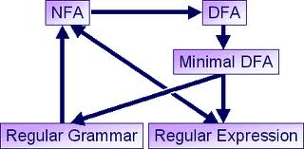
Regular Expressions
Course Instructor: Dr. Sohail Iqbal

Slide 2
Course Objectives
The main Objective is to answer and question the following
1. What is Automata?
2. How automata relate to formal languages
3. What is the fundamental model of a Computing machine?
4. What are formal languages and their relationship to a programming language?

Slide 3
Regular Language
A Language is regular if there is a DFA that accepts it
Since any language accepted by a DFA is also accepted by an NFA (equivalence)
A regular language can be associated with an NFA too
What else? Regular Expression!

Slide 4
Regular Expressions
Regular expressions
describe regular languages
Example:
describes the language
Next, we see how this language is created

Slide 5
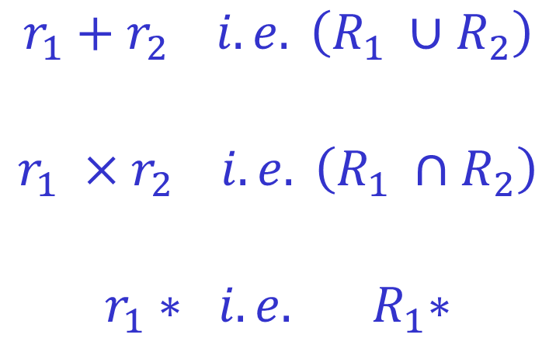
Recursive Definition
Primitive regular expressions:
for some α in alphabet Σ
Given regular expressions and
$$r_{1}+r_{2} i.e. \left(R_{1} ∪R_{2}\right)$$
$$r_{1} ×r_{2} i.e. \left(R_{1} ∩R_{2}\right)$$
$$r_{1}∗ i.e. { R}_{1}∗$$
Are regular expressions

Slide 6
Examples
A regular expression:
Not a regular expression:

Slide 7
Languages of Regular Expressions
: language of regular expression
Example

Slide 8
Definition
For primitive regular expressions:

Slide 9
Definition (continued)
For regular expressions and

Slide 10
Example
Regular expression:

Slide 11

Example
Regular expression
Compute yourself L(r):
$$r=\left(bb+a\right).{\left(aa\right)}^{∗}$$
Hint. Try to find the different strings

Slide 12
Example
Regular expression

Slide 13
Example
Regular expression
= { all strings containing substring 00 }

Slide 14
Example
Regular expression
= { all strings without substring 00 }
How?

Slide 15
Equivalent Regular Expressions
Definition:
Regular expressions and
are equivalent if

Slide 16
Example
= { all strings without substring 00 }
and
are equivalent
regular expressions

Slide 17
Assignment 2 Solve Q. 1.20 by Thu 27 Feb
Make a pdf of your handwritten solution and upload on LMS.

Slide 18
Questions?
Thank You!

